Slide 1


Slide 2

#LifeKoKaroLift
SGC Coaching:
Articulate your Journey | Activate Students’ Vigour| Accelerate Mutual Growth
Session 1
Python programing and Pandas

Slide 3
Agenda: Session 1
Introduction/ Quick Recap –(25 mins)
Last 2 weeks: Creating a rapport with learners/ assessing their knowledge areas
Focused Teaching –(40 mins)
Learn Python Programming through Example exercises
Personalized Feedback/
Doubt resolution –(25 mins)
Discuss through Individual Notebooks

Slide 4


Introductions
Key aspects to be covered
Coach:
Current Role
Journey in Data Science

Slide 5
Introductions
Key aspects to be covered
Students
Your Aspirations
Prior technical background and role
Coding experience (if Yes, tools)
Current challenges in programming (if Any)
Learning Goals in Data Science

Slide 6
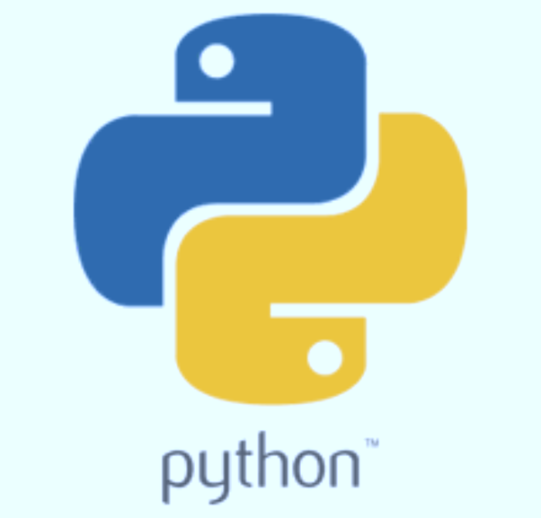

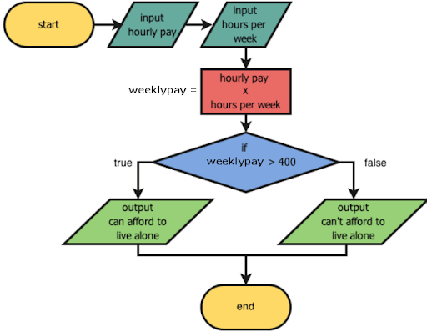
Recap: What the learner have learnt in the week
Python Programming
Get familiar with Python tool
Prepare data using Python packages
Enhance Logic:
Flow Diagram
Data types
Control structures
Functions
Solving basic problems
Pandas/ Numpy
Cleaning/ Data Manipulation
Extraction/ Querying
Notes:
Ask this particularly in Non-Technical / Non-Experienced groups

Slide 7
Quiz Time!
‘Welcome Students’ can be split as ‘Welcome’ and ‘students’ using string operations (True/False)? Why or why not?
You get an input and you have to check whether it is an even number. Repeat the experiment till you get 3 evens. Which type of loop is suited in this case?
For an input integer, you need to return an identity matrix. Which function is suitable for this case?
Combine two lists a and b in 1 list but return only unique values between 2 sets.
Notes:
You can choose other examples but they must be simple enough for a beginner. The interaction matters more in this case.

Slide 8
Tips from Experience
Production vs Prototype
Java vs Python vs R
Jupiter notebook vs Python Script.
Team vs Individual.
Local code vs Github.
Code Documentation.
Code Quality.
Practice, practice, practice.

Slide 9
Focussed teaching: Practice with open source data
Industry Relevance of Data Science
Python for data wrangling
Understanding features of Python packages
Using random dataset/ open source data for illustrations

Slide 10

Industry Relevance of Python coding
Objective
Illustrating the importance of coding to get answers to business questions
Actions
Discuss live business examples of data science (Mentor driven)
It must cover the following purposes:
Data handling
Analysis
Modelling Approaches
Advanced application (if possible, e.g. Image, text processing)
Notes:
For those who have less coding background, elaborate on the importance of coding along with the fact that logic and solutions are more important.
For people who feel “ I don’t want to do coding”, explain its relevance and the overall picture of a data scientist role to allay their fears.

Slide 11
Let’s Code Together
Coding Time

Slide 12

Personalized Feedback and Doubt resolution
Doubt Resolution
Questions??

